Slide 1




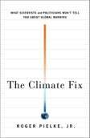
11/26/2015
You Can’t Say That!
Journalism, Science and Politics
Roger A. Pielke, Jr. University of Colorado
20 November 2015
@VWN
Delft, Netherlands
CENTER FOR SCIENCE AND TECHNOLOGY POLICY RESEARCH
CIRES/University of Colorado at Boulder http://sciencepolicy.colorado.edu
Questions NOT addressed in this talk
Is human-caused climate change real and/or significant?
  Me: Yes it is
What policies makes sense in response?
  Me: Read my book!
slide 2

Slide 2



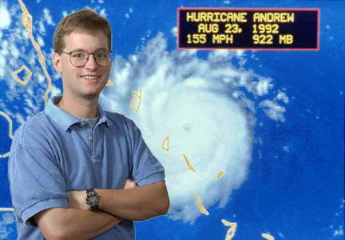
11/26/2015
An Initial Warning!
“You should come with a warning label:
Quoting Roger Pielke will bring a hail storm down on your work from the London Guardian, Mother Jones and Media Matters.”
Paige St. John
Los Angeles Times & Pulitzer Prize winning reporter 20 October 2015
slide 3
I have studied extreme events since 1993
slide 4

Slide 3
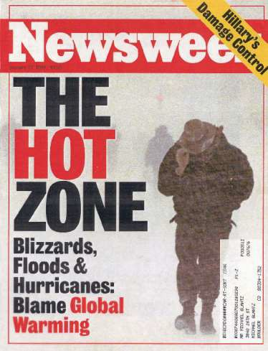
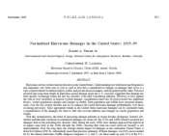
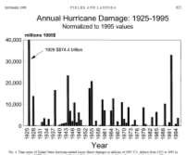
11/26/2015
My start in extreme weather & climate research
NEWSWEEK, January 1996
A STRIKING JUXTAPOSITION
•1991-1994 was the least active 4-year period for hurricane activity in at least 50 years (Landsea et al. 1996)
•1991-1994 was the most costly four-year period for hurricane damage ever
slide 5
Pielke and Landsea (1998) Normalized Hurricane Losses
From our conclusions:
“. . . it is only a matter of time before the nation experiences a $50 billion or greater storm, with multibillion dollar losses becoming increasingly frequent. Climate fluctuations that return the Atlantic basin to a period of more frequent storms will enhance the chances that this time occurs sooner, rather than later.”
Pielke and Landsea (1998)
Hurricane Katrina in 2005 had damages of $81 billion
slide 6

Slide 4
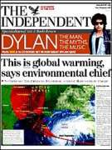
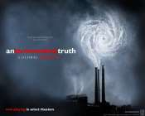



11/26/2015
Climate & extreme weather became linked
By the mid-2000s this research area had matured enough that it made sense to begin asking how it all added up globally
The issue of extreme weather events became politically contentious in the climate debate
The IPCC was preparing its AR4
slide 7
Hohenkammer workshop in May, 2006
slide 8

Slide 5
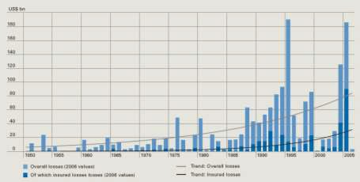


11/26/2015
Increasing global losses
Source: Munich Re 2007
slide 9
Hohenkammer Workshop May, 2006
•Co-sponsors: US NSF, Munich Re, GKSS Institute for Coastal Research, Tyndall Centre for Climate Change Research
•32 participants from 16 countries
•24 background “white papers”
•Summary consensus report
•Consistent with IPCC WGI
slide 10

Slide 6

11/26/2015
Hohenkammer Workshop May, 2006
•Analyses of long-term records of disaster losses indicate that societal change and economic development are the principal factors responsible for the documented increasing losses to date.
•Because of issues related to data quality, the stochastic nature of extreme event impacts, length of time series, and various societal factors present in the disaster loss record, it
is still not possible to determine the portion of the increase in damages that might be attributed to climate change due to GHG emissions
•In the near future the quantitative link (attribution) of trends in storm and flood losses to climate changes related to GHG emissions is unlikely to be answered unequivocally.
slide 11
IPCC AR4 2007
slide 12

Slide 7
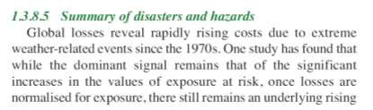

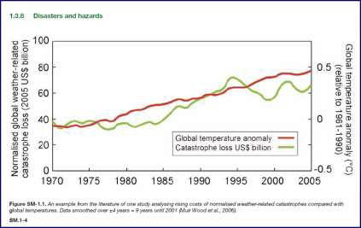
11/26/2015
IPCC 2007: Reliance on “one study”
slide 13
IPCC asserts a link between warming and catastrophes
slide 14

Slide 8
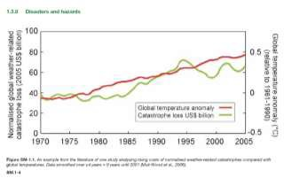
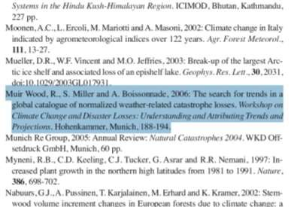
11/26/2015
Relies on “one study” -- What is that ”one study”?
slide 15
The “one study” was a 2006 workshop paper
slide 16

Slide 9

11/26/2015
Hey look!
I co-organized that workshop!
slide 17
Guess what?
•The graph from the IPCC does not appear in Muir-Wood 2006, nor does the underlying data!
•In early 2010 during a public debate at the Royal Institution in London, Robert Muir-Wood revealed that he had created the graph, included it in the IPCC and then intentionally miscited it in order to circumvent the IPCC deadline for inclusion of published material.
•IPCC Lead Author Muir-Wood (and RMS) said that the graph should never have been included in the report
•In 2006 Risk Management Solutions (the company that employs RM-W) predicted that the risk of US hurricane damages had increased by 40%, necessitating much higher insurance and reinsurance premiums ($82 billion according to Sarasota Herald Tribune)
slide 18

Slide 10

11/26/2015
IPCC expert review process . . .
IPCC 2007 Expert reviewer comment:
I propose "Since 1970 the global normalized results do not show any statistically significant correlation with global temperatures." and to remove the end of the paragraph and the figure 1,5 because it can mislead a reader not familiar with correlation.
slide 19
Another expert comment and IPCC response
IPCC 2007 Expert reviewer:
“I think this is inappropriate. It leads the reader into interpreting recent events in a particular way without providing supporting information. This suggestion, that the losses in 2004 and 2005 draw Pielke's results into question, needs to be supported with a reference or a solid in chapter assessment. What does Pielke think about this?”
Francis Zwiers, Canadian Centre for Climate Modeling and Analysis
IPCC response:
“I believe Pielke agrees that adding 2004 and 2005 has the potential to change his earlier conclusions – at least about the absence of a trend in US Cat losses.”
slide 20

Slide 11

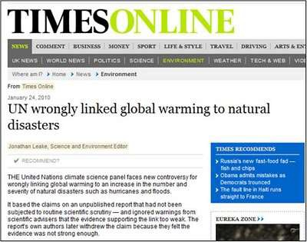
11/26/2015
What the mis-cited source for the IPCC graph actually said when finally published in 2008
“We find insufficient evidence to claim a statistical relationship between global temperature increase and normalized catastrophe losses.“
Miller et al. 2008
(RM-W was a co-author)
slide 21
The UK Sunday Times – 24 January 2010
slide 22

Slide 12


11/26/2015
IPCC Press Release – 25 January 2010
“The January 24 Sunday Times ran a misleading and baseless article attacking the way the Fourth Assessment Report of the IPCC handled an important question concerning recent trends in economic losses from climate-related disasters”
“… a baseless attack … This section of the IPCC report is a balanced treatment of a complicated and important issue.”
“In writing, reviewing, and editing this section, IPCC procedures were carefully followed to produce the policy-relevant assessment that is the IPCC mandate.”
slide 23
IPCC AR4 on disasters – “Nothing wrong”
•The IPCC included a “misleading” graph
•That graph does not appear in the literature (grey or otherwise, before or after)
•The IPCC violated its procedures
•The IPCC ignored its reviewers (who asked that the graph be removed)
•The IPCC made up a misleading response about my views
The bottom line? There is no signal (yet) of the effects of increasing
atmospheric carbon dioxide in the rising toll of disasters
The IPCC failed comprehensively on this issue. Seeking to argue otherwise flies in the face of science, common sense and what is abundantly obvious.
This issue is not characterized by nuance or ambiguity.
slide 24

Slide 13
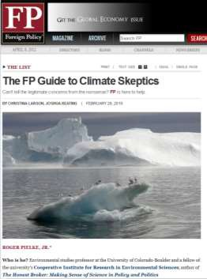
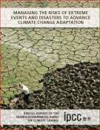
11/26/2015
26 February 2010
slide 25
FROM THE ARTICLE:
“Chief beef: Hurricanes and the bottom line
Telling quote: "We cannot make a causal link between increase in greenhouse gases and the costs of damage associated with hurricanes, floods, and extreme weather phenomena." —interview with FP
. . . For his work questioning certain graphs presented in IPCC reports, Pielke has been accused by some of being a climate change "denier.””
IPCC 2012 SREX on disaster losses
“Long-term trends in economic disaster losses adjusted for wealth and population increases have not been attributed to climate change, but a role for climate change has not been excluded (medium evidence, high agreement).”
IPCC SREX 2012
slide 26

Slide 14

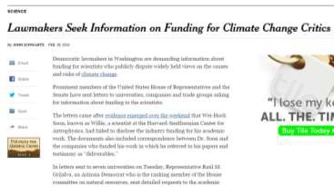

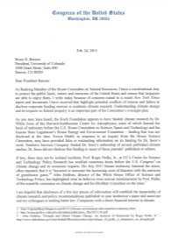
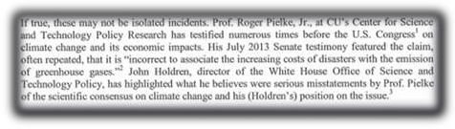
11/26/2015
The “investigation” of me 2015
slide 27
Representative Grijalva’s letter
slide 28

Slide 15

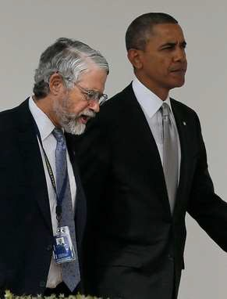

11/26/2015
My 2013 Senate EPW testimony
slide 29
February 2014 – John Holdren, Science Advisor
slide 30

Slide 16
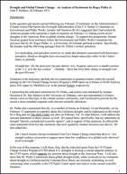
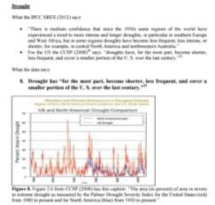

11/26/2015
John Holdren: 6 Pages on 15 Words (!)
The entirety of my 2013 Senate Testimony on Drought
John Holdren’s wrote 6 pages in response
slide 31
One more . . .
slide 32

Slide 17

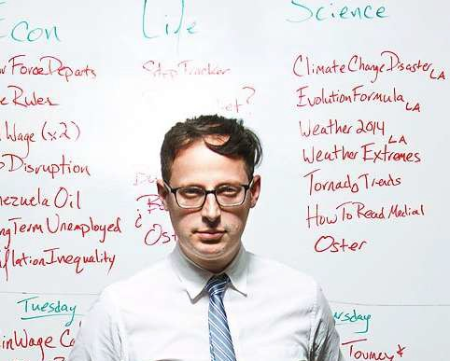
11/26/2015
slide 33
slide 34

Slide 18
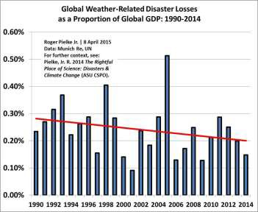






11/26/2015
Total Weather Disaster Losses as % of global GDP
slide 35
When journalists attack …
The online magazine Salon explained that I was “the target of a furious campaign of criticism from other journalists in the field, many of whom say he presents data in a manipulative and misleading way.” Salon called for me to be fired, and labeled me a “climate change denialist.” Paul Krugman, a Nobel Prize winning economist and New York Times columnist labeled me a “known irresponsible skeptic.”
slide 36

Slide 19
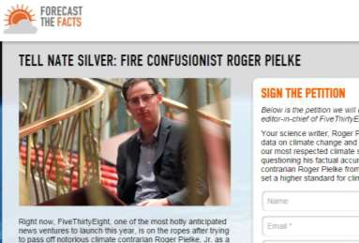

11/26/2015
Fire him!
slide 37
So I lost my job
slide 38

Slide 20


11/26/2015
Let’s quickly look at some data
The latest science on trends in extreme events
  Hurricanes (tropical cyclones)
  Tornadoes
  Floods
  Drought
  Other (temperatures, extreme precipitation)
slide 39
A new book!
slide 40

Slide 21
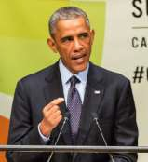
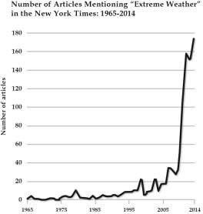

11/26/2015
President Obama: June 29, 2013
“W]hile we know no single weather event is caused solely by climate change, we also know that in a world that’s getting warmer than it used to be, all weather events are affected by it – more extreme droughts, floods, wildfires, and hurricanes. . .
And Americans across the country are already paying the price of inaction in higher food costs, insurance premiums, and the tab for rebuilding.”
slide 41
Hype vs. Data – “extreme weather” in the NY times 1860-2014
slide 42

Slide 22

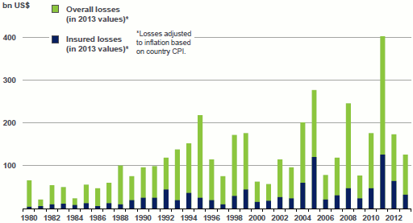
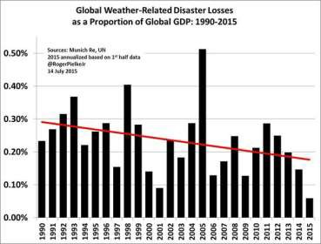
11/26/2015
Global disaster losses (Munich Re 2014)
slide 43
Total Weather Disaster Losses as % of global GDP
slide 44

Slide 23

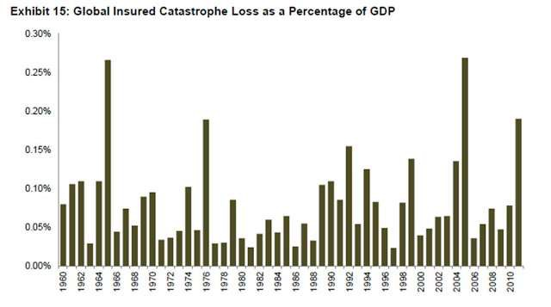
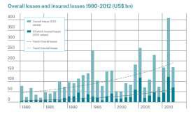
11/26/2015
Insured losses as % of Global GDP
Source: Aon Benfield 2013
slide 45
Peer-reviewed science tells a consistent story
“The absence of trends in normalized disaster burden indicators appears to be largely consistent with the absence of trends in extreme weather events.”
Visser et al. 2014
Climatic Change
slide 46

Slide 24
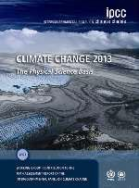
11/26/2015
IPCC AR5 – Extreme temperatures
“[T]here is medium confidence that globally the length and frequency of warm spells, including heat waves, has increased since the middle of the 20th century although it is likely that heatwave frequency has increased during this period in large parts of Europe, Asia and Australia.”
“Medium confidence: increases in more regions than decreases but 1930s dominates longer term trends in the USA.”
slide 47
IPCC AR5 – Extreme precipitation
“[I]t is likely that since 1951 there have been statistically significant increases in the number of heavy precipitation events (e.g., above the 95th percentile) in more regions than there have been statistically significant decreases, but there are strong regional and subregional variations in the trends.”
“[T]here is medium confidence that anthropogenic forcing has contributed to a global scale intensification of heavy precipitation over the second half of the 20th century in land regions where observational coverage is sufficient for assessment.”
Note: “Likely” = >66%
slide 48

Slide 25
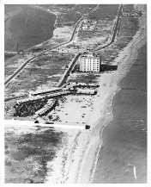
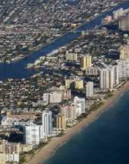
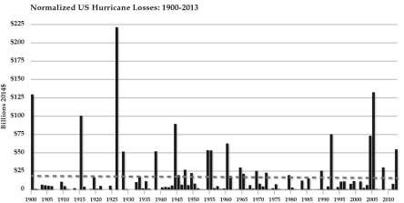
11/26/2015
Society changes in dramatic fashion
Miami Beach 1926
Miami Beach 2006
Losses increasing?
Wendler Collection
Joel Gratz © 2006
slide 49
Updated, 1900-2013 (2014 & 2015 had ~$0)
slide 50

Slide 26
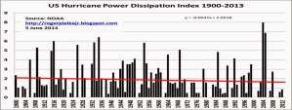
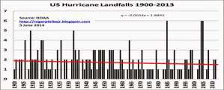
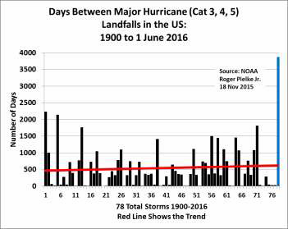
11/26/2015
Use climate data as a check on normalization results
With no upwards trends in hurricane landfall frequency or intensity, there is simply no reason to expect to see an upwards trend in normalized losses.
slide 51
The current US Intense Hurricane Drought
slide 52

Slide 27
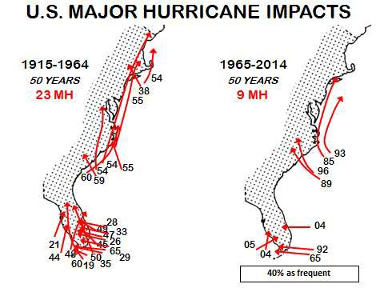
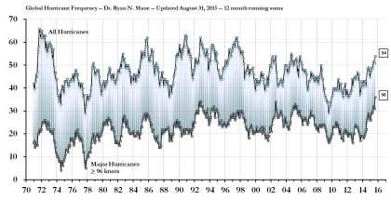
11/26/2015
Where did they go?
Source: P. Klotzbach
slide 53
A global view of tropical cyclone trends
Source: Ryan Maue, after Maue (2011) http://models.weatherbell.com/global_major_freq.png
slide 54

Slide 28
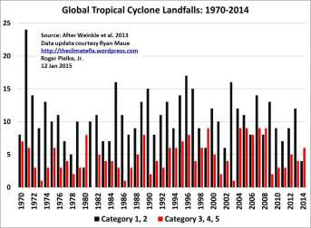
11/26/2015
Global landfalls updated through 2014 . . .
slide 55
IPCC AR5 – Tropical cyclones
“Current datasets indicate no significant observed trends in global tropical cyclone frequency over the past century .”
“No robust trends in numbers of tropical
annual storms,
hurricanes and major hurricanes counts have been identified over the past 100 years in the North Atlantic basin.”
slide 56

Slide 29
11/26/2015
IPCC AR5 – Floods
“In summary, there continues to be a lack of evidence and thus low confidence regarding the sign of trend in the magnitude and/or frequency of floods on a global scale.”
slide 57
IPCC SREX co-authors – Floods
“a direct statistical link between anthropogenic climate change and trends in the magnitude/frequency of floods has not been established...
There is such a furore of concern about the linkage between greenhouse forcing and floods that it causes society to lose focus on the things we already know for certain about floods and how to mitigate and adapt to them. Blaming climate change for flood losses makes flood losses a global issue that appears to be out of the control of regional or national institutions. The scientific community needs to emphasize that the problem of flood losses is mostly about what we do on or to the landscape and that will be the case for decades to come.”
Zbigniew et al. 2014
Hydrological Sciences Jopurnal
slide 58

Slide 30
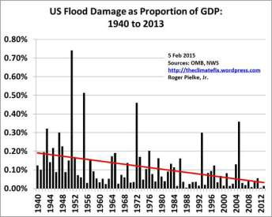
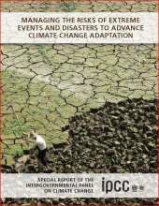
11/26/2015
Getting better
slide 59
IPCC SREX – Tornadoes
“There
is low confidence in
observed trends in small spatial-scale phenomena such as tornadoes and hail.”
slide 60

Slide 31
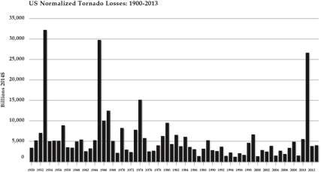
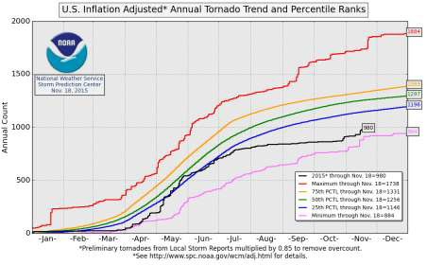
11/26/2015
Normalized Tornado Losses in the US
slide 61
2015 US Tornadoes – near-record low
slide 62

Slide 32
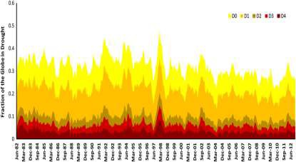
11/26/2015
IPCC AR5 – Drought
“There is not enough evidence to support medium or high confidence of attribution of increasing trends to anthropogenic forcings as a result of observational uncertainties and variable results from region to region. .
. we conclude consistent with SREX that there is low confidence in detection and attribution of changes in drought over global land areas since the mid-20th century.”
“Recent western
long-term
droughts in
North
America
cannot
definitively be shown to lie outside the very large envelope of natural precipitation variability in this region”
slide 63
Fraction of the earth in drought: 1982-2012
Hao et al. 2014
Scientific Data
http://www.nature.com/articles/sdata20141
slide 64

Slide 33




11/26/2015
Summary – You can’t say that!
Have disasters become more costly because of human-caused climate change?
Only one answer to this question is strongly supported by the available data, the broad scientific literature and the assessments of the IPCC:
No.
There is exceedingly little evidence to support claims that disasters have become more costly because of human caused climate change.
slide 65
Professor vs. NY Times?
“. . . leaked his e-mails to three journalists... [one] wrote a front-page New York Times news story highlighting a $25,000 donation from Monsanto to Folta's institution. . . the reporters cherry-picked sentences from several thousand e-mails, highlighting Folta's communications with Monsanto, often out of context, to insinuate that he is an industry shill—and thus presumably unfit to talk to the public.”
Nature Biotechnology 2015
slide 66

Slide 34









11/26/2015
Standing up for Science
“This is how demagogues and anti-science zealots succeed: they extract a high cost for free speech; they coerce the informed into silence; they create hostile environments that threaten vibrant rare species with extinction.”
Nature Biotechnology October 2015
slide 67
Thank you!
pielke@colorado.edu
Papers etc. can be downloaded from: http://sciencepolicy.colorado.edu
http://rogerpielkejr.com/
2007
2010
2010
2014
slide 68

